Slide 1
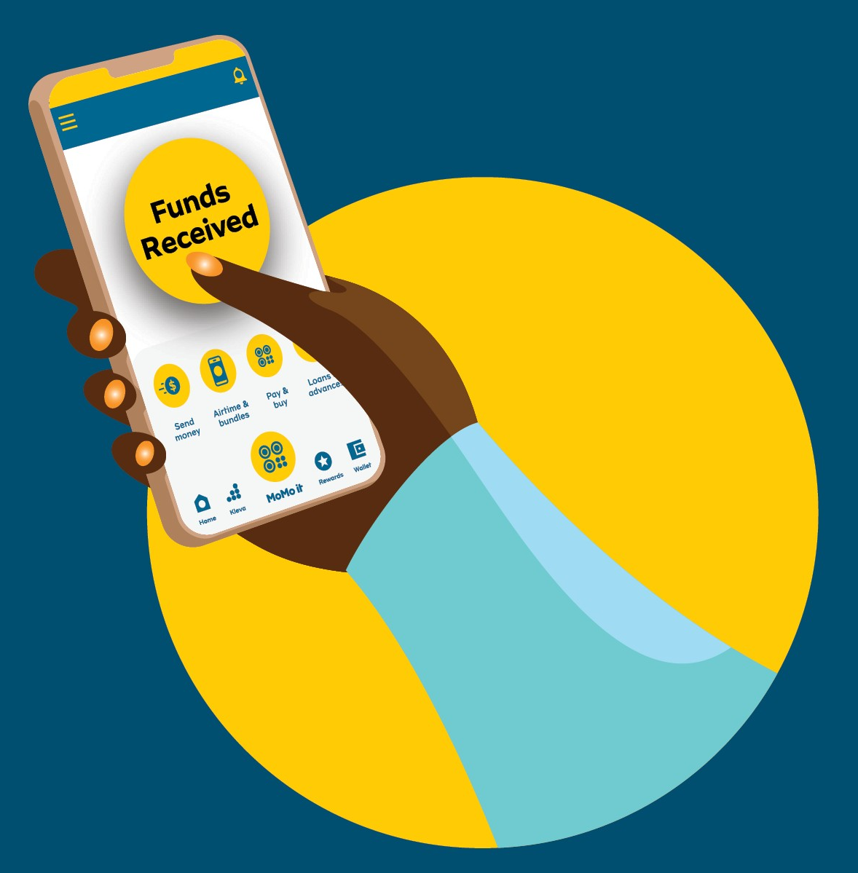
MoMo, Digital Payments & Financial Inclusion
Building Africa’s Digital Economy

Slide 2
Contents
01
MoMo & digital payment integrations
02
Digital financial services & financial inclusion
03
Opportunities and three lessons
Notes:
Two halves: the rails themselves, then what they unlock. Close with three lessons.

Slide 3
01
MoMo & Digital Payment Integrations
Notes:
Start with the plumbing before the impact.

Slide 4
The Evolution of Payments in Africa
01
02
03
Cash economy
Mobile money
Digital ecosystems
Value moved physically. Distance to a branch, not willingness to save, decided who took part in the formal financial system.
The phone became the account. Africa leapfrogged traditional banking because handset adoption ran far ahead of branch networks.
Wallets became rails that other businesses build on — commerce, lending, payroll and cross-border transfers.
Examples: M-Pesa (Kenya) · MTN MoMo (Ghana, Uganda) · Orange Money (West Africa)
Notes:
Africa leapfrogged branch banking because the phone arrived before the branch did. M-Pesa in Kenya, MTN MoMo in Ghana and Uganda, Orange Money across West Africa.

Slide 5
What is Mobile Money?
Store value
Send and receive funds
A wallet held against a phone number, no branch visit required.
Person to person, business to person, and back again.
Pay merchants
Access savings, loans and insurance
Acceptance at the counter, online, and in the field.
Financial products delivered through the same wallet.
Mobile Money is no longer just a wallet; it is digital infrastructure.
Notes:
Four functions. Emphasise the key message: this is infrastructure, not an app feature.

Slide 6
How MoMo APIs Power Innovation
API
WHAT IT DOES
REAL USE CASE
Collections
Receive payments
E-commerce checkout
Disbursements
Bulk payouts
Gig economy payouts
Remittances
Move funds across borders
School fees from abroad
KYC services
Verify identity
Ride-hailing onboarding
Notes:
Each API is one line of integration work and one whole category of product. This is where students will actually touch the system.

Slide 7
African Startups Built on Digital Payments
Flutterwave
Chipper Cash
Hubtel
Nigeria. Payment infrastructure for merchants across the continent.
Uganda. Cross-border transfers between African markets.
Ghana. Commerce and payment services for local businesses.
Yango payments integration
Agricultural and merchant payment solutions
Notes:
Key message: APIs create opportunities for entrepreneurs. None of these companies built a payment network — they built on one.

Slide 8
02
Digital Financial Services & Financial Inclusion
Notes:
Shift from rails to outcomes.

Slide 9
What is Financial Inclusion?
Access and use
Why it matters
Payments
Savings
Credit
Insurance
Economic empowerment
Poverty reduction
Business growth
Notes:
Inclusion is access AND use. Define it, then say why it matters economically.

Slide 10
How Mobile Money Drives Inclusion
Reaches the unbanked
Reduces distance to financial services
Supports women-led businesses
Enables low-cost transactions
Sub-Saharan Africa’s growth in account ownership has been heavily driven by mobile money adoption. — World Bank
Notes:
World Bank Findex: Sub-Saharan Africa's growth in account ownership has been heavily driven by mobile money adoption.

Slide 11
African Success Stories
MARKET
WHAT MOBILE MONEY CARRIES THERE
Kenya
M-Pesa enabling digital commerce
Ghana
MoMo supporting payments, remittances, merchant acceptance and lending initiatives
West Africa
Rapid growth in mobile money adoption and digital payments
Notes:
Three markets, three shapes of the same story.

Slide 12
The Future of Digital Financial Services
Deepening the wallet
Extending the rails
Embedded finance
Digital lending
Virtual cards
Digital identity and eKYC
Cross-border payments
Stablecoins and emerging payment rails
Notes:
Where the next five years of building happens. Keep it brief — this is a signpost, not a deep dive.

Slide 13
03
Opportunities and Three Lessons
Notes:
Turn to the audience.

Slide 14
Opportunities for Students
Build
Shape
Protect
Fintech entrepreneurship
Software engineering & APIs
Product management
Data analytics
Cybersecurity
Compliance & regulation
Notes:
Six routes in. Every one of these roles exists inside a payments company today.

Slide 15
03 · OPPORTUNITIES
“What problem in your community could be solved using digital payments?”
A question to take away
Notes:
Leave this on screen. Ask for two or three answers from the room before moving on.

Slide 16
3 Lessons for Future Innovators
01
02
03
Solve real problems
Build for inclusion
Leverage existing rails
Not just technical problems. The best payment products remove a queue, a trip, or a fee that someone feels every week.
Not only convenience. Design for the person with one handset and no branch nearby, and the product works for everyone else too.
Rather than reinventing them. The networks are already there, documented and open — the opportunity is what you put on top.
Notes:
The three things to remember if they remember nothing else.

Slide 17
Thank you
Questions, and the problems you would build for.
winston.quartey@mtn.com
Notes:
Thank the room and open the floor.

